Slide 1

Hospital management system -BYTEXL

Slide 2
TeaM MEMBERS
*Md.Sana Fathima Sulthana-24KB1A05AM(TEAM LEAD)
*M.Muni Saranya-24KB1A05AF
*M.Nandini-24KB1A05AP
*N.Jashwitha-24KB1A05BU

Slide 3
Introduction of the project
The Hospital Management System is a CONSOLE-BASED Application designed to help hospitals manage patient records and Appointment Scheduling.
In the modern healthcare environment, efficient and accurate management of patient information and appointments is critical for delivering quality service.
This project developed in C, using fundamental data structures-ARRAY and LINKED LIST can streamline patient registration and appointment tracking.

Slide 4

Problem statement
Manual handling of patient and appointment data in hospitals is prone to errors, time-consuming and inefficient.
There is a lack of a simple, lightweight digital solution for small clinics or healthcare facilities that don’t require large-scale systems but still need reliable management of basic information.

Slide 5
Drawbacks of previous system
*Manual record-keeping leads to data redundancy and human errors.
*Searching and updating records is time-consuming.
*Appointments may clash or get lost in manual logs.
*Lack of data organization affects patient service quality.

Slide 6
Objective
To develop a simple,efficient C-based Hospital Management System that:
#Stores and retrieves patient details using an array
#Schedules and manages appointments using a linked list.
#Supports searching and deleting operations.
#Provides a user-friendly menu-driven interface for ease of use.

Slide 7

System overview
This system allows hospital staff to:
Add, view and search patient records.
Add, view and delete appointments.
The program runs in a terminal and provides structured output and input prompts for all operations.

Slide 8
Technologies and tools
Programming Language:C
Data Structures:Array(for patients), Linked List(for appointments)
Complier:Online GDB
Platform:Windows or Linux terminal

Slide 9
Work flow
1.Launch the application.
2.User chooses an option from the main menu:
*Add patient
*Display/Search patients
**Add/View/Delete appointments
3.System processes the requests and updates memory.
4.Output is displayed based on user input.
5.System loops back to the main menu for further actions.

Slide 10
Modules in project
Patient Module:
*Add new patient
*Display all patients
*Search patient by name or ID
#Appointment Module:
*Add Appointment
*Display Appointments
*Delete appointment by patient ID

Slide 11
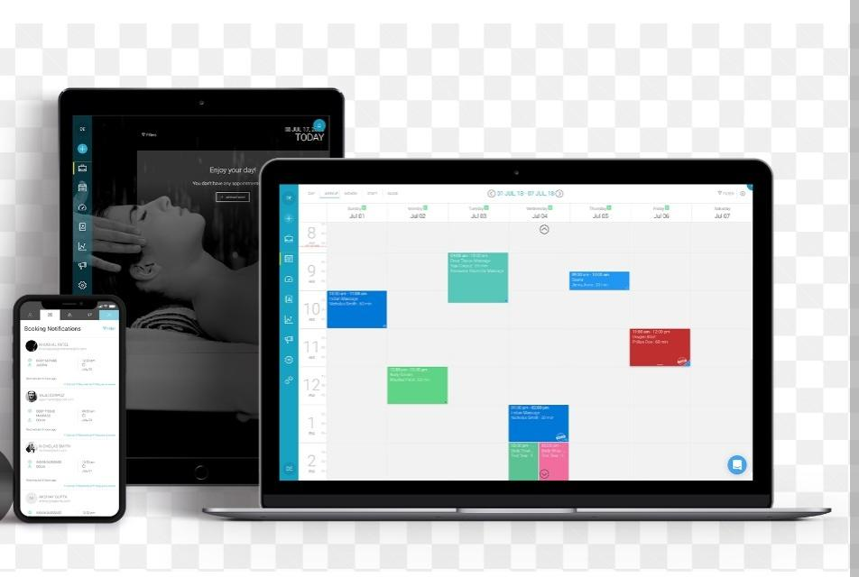
Advantages
*Simple and suitable for small clinics or academic use.
*Fast data access and manipulation using basic data Structures.
*No need for external databases.
*Good practical implementation of Array and Linked List

Slide 12
Challenges
Handling string input safely in C(avoid buffer overflows).
Managing memory dynamically using linked lists(e.g., deletion)
Avoiding data loss due to the lack of persistent file storage.
Ensuring user input is validated and error-free during implementation.

Slide 13
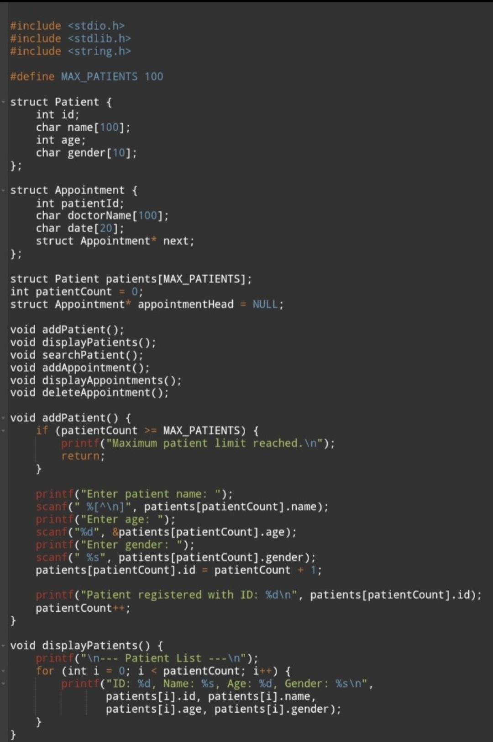
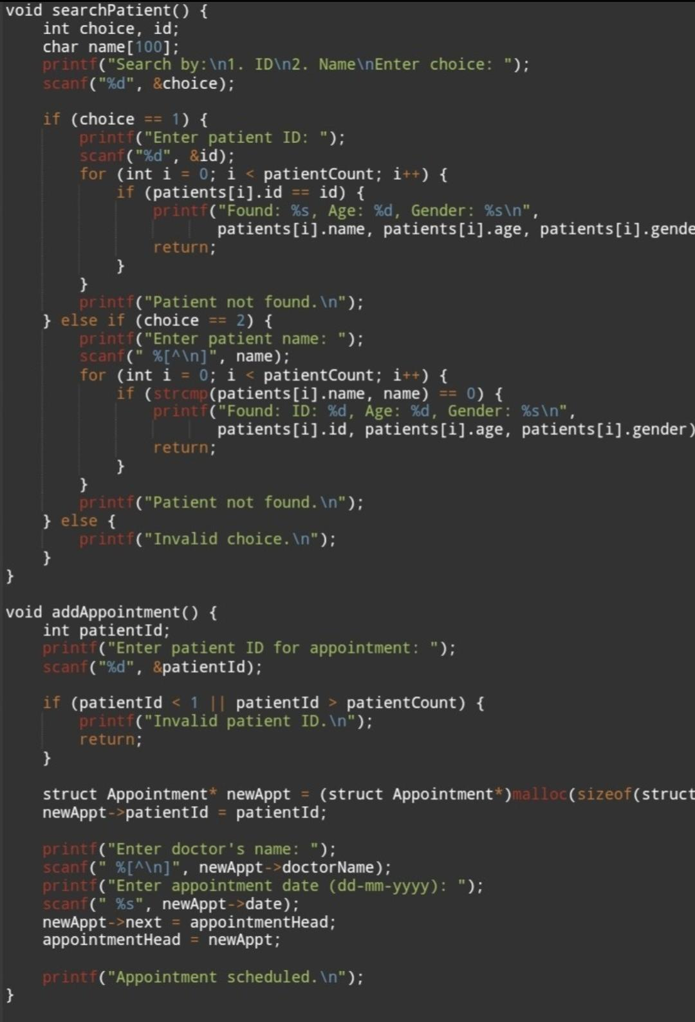
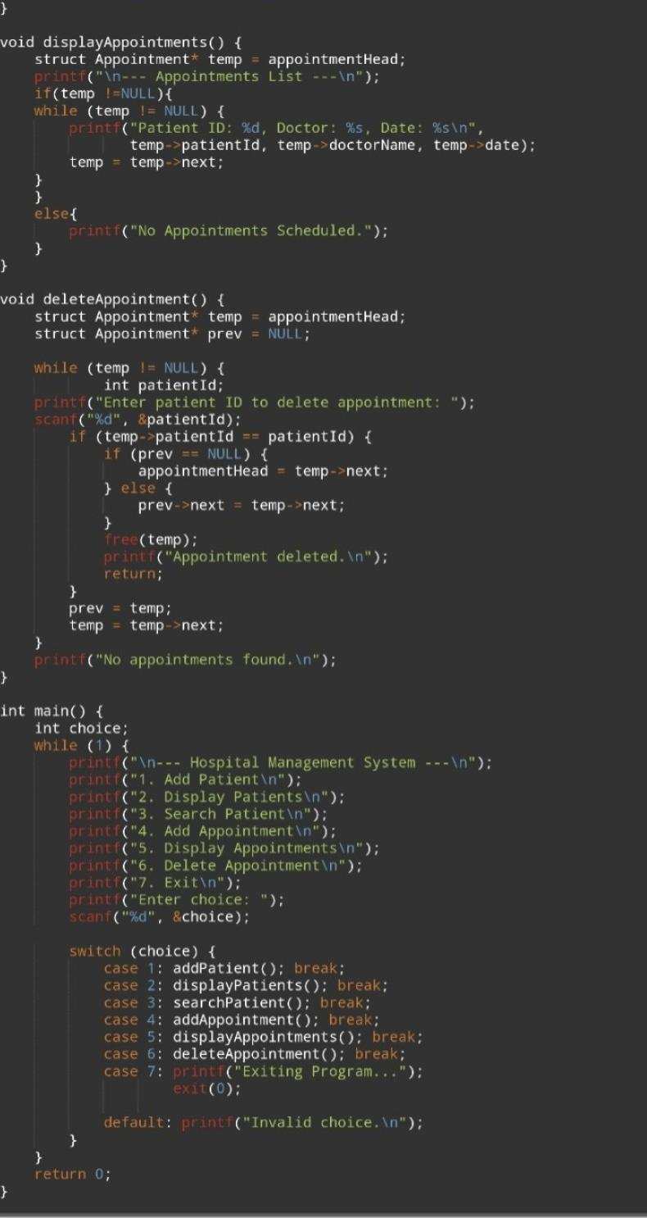
Source code

Slide 14
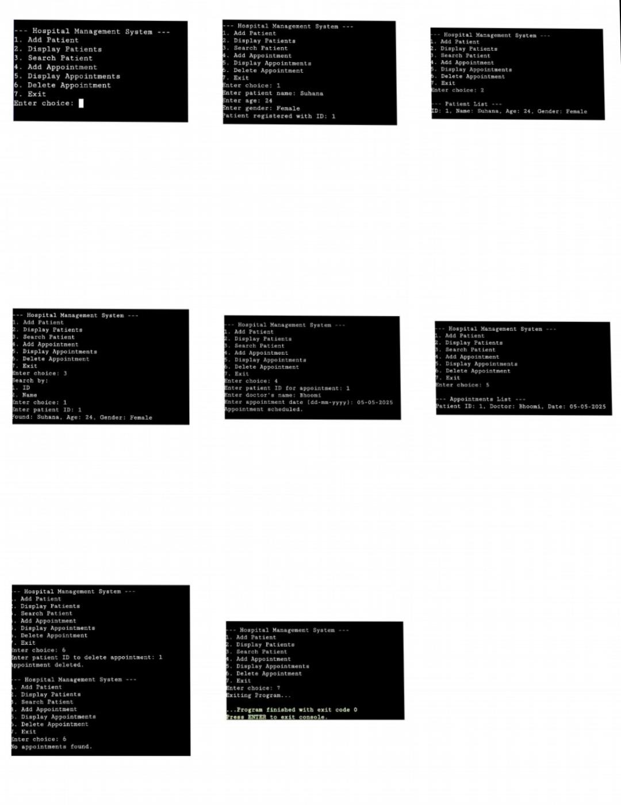
Output:

Slide 15
Conclusion
The Hospital Management System developed using C provides a foundational solution for organizing patient data and scheduling appointments in a structured, efficient manner.
The project shows practical application of core Data Structures.
Although basic, it effectively addresses the challenges of manual record-keeping and can be further enhanced with features like file storage.
This project not only fulfills it’s objective but also reinforces the importance of structured programming and logical problem solving in real-world Systems.

Slide 16


